Slide 1
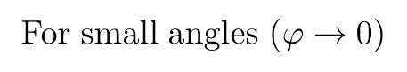
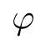
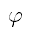
A
B
A
$$φ$$
For small angles ($φ→0$)
Total restoring torque
$$φ$$
N
(2)
M
r
O
P
M
N
Q

Slide 2
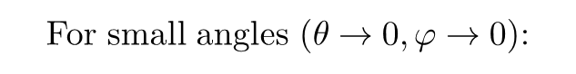
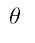
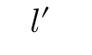
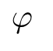
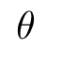
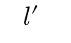
For small angles ($θ→0,φ→0$):
A
B
A
M
d
N
$$φ$$
$$φ$$
l
r
l
$$l′$$
$$l′$$
$$θ$$
N
d
r
$$θ$$
M
d
N
M
O
P
O
Q
(3)

Slide 3
Stand
Rods (as cantilever beam)
Precaution 1
r
Filar suspended by capstan
Filar
Precaution 2
l
Location of G-clamp
Suspending rod
Camera
Precaution 3

Slide 4
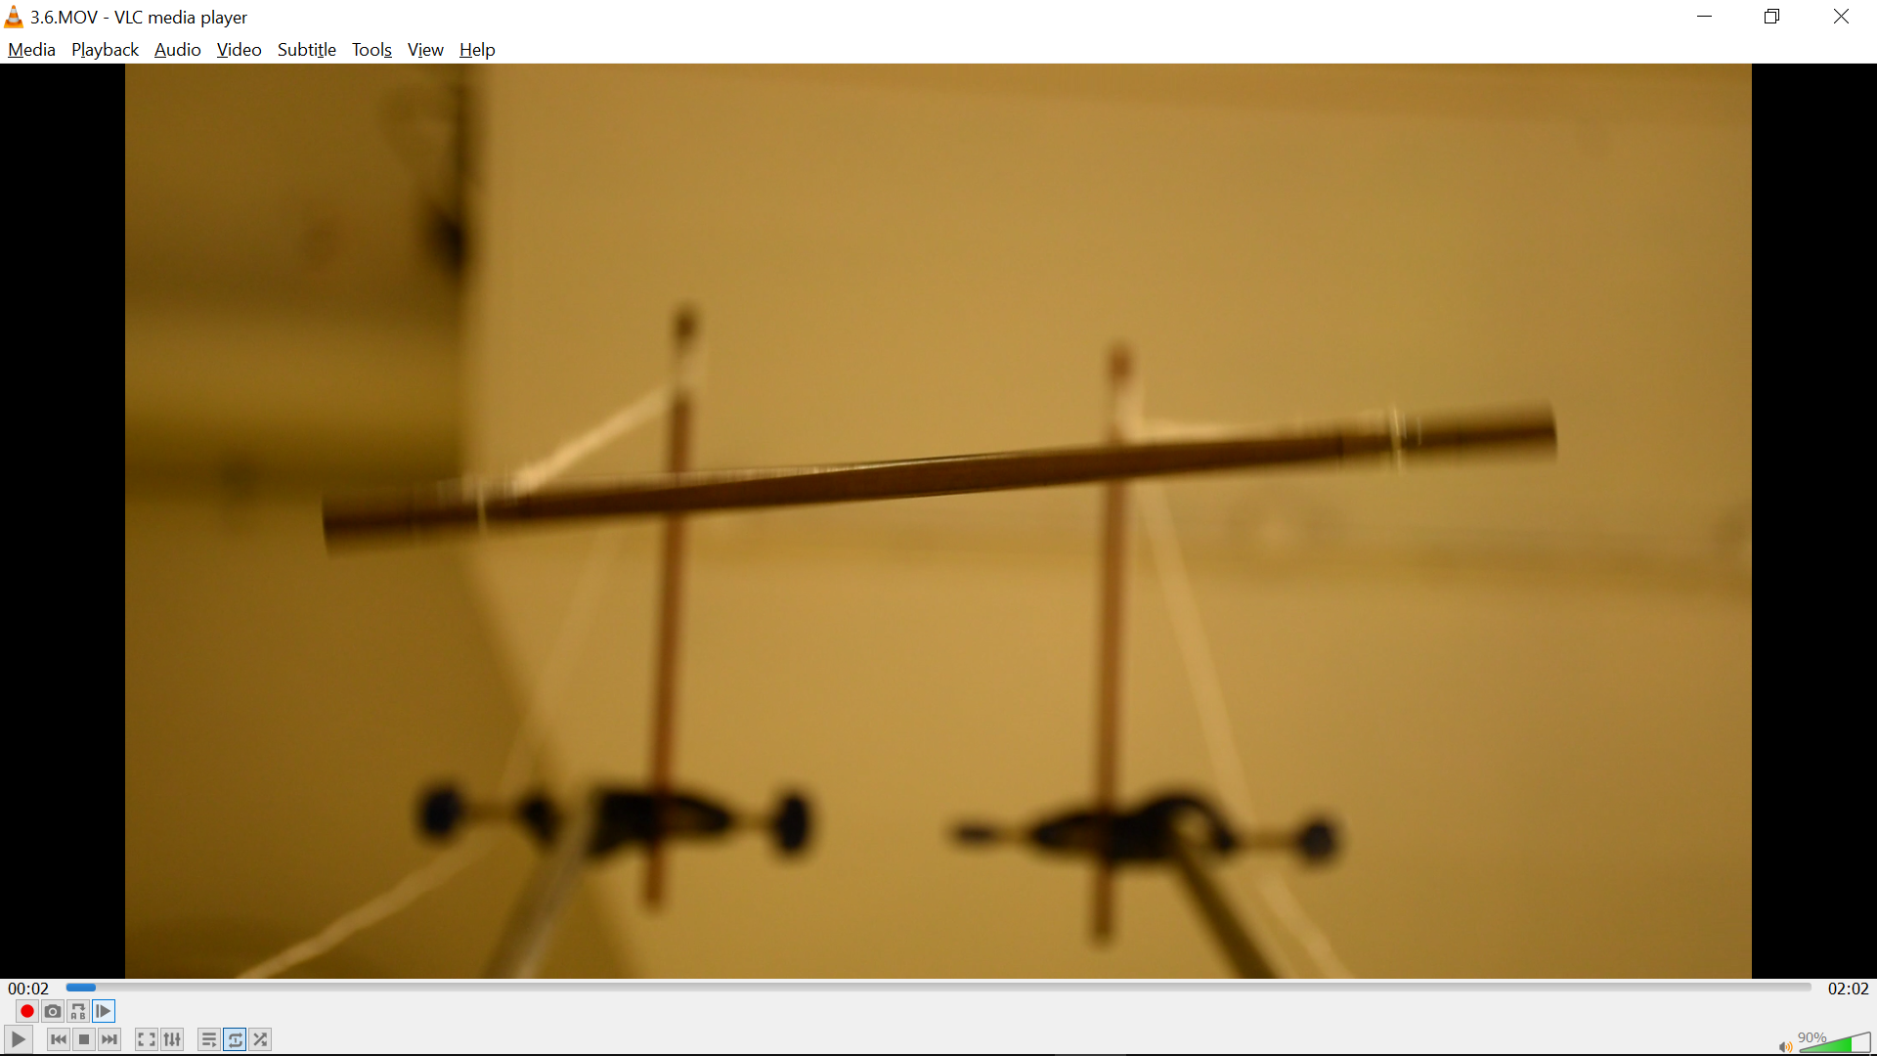
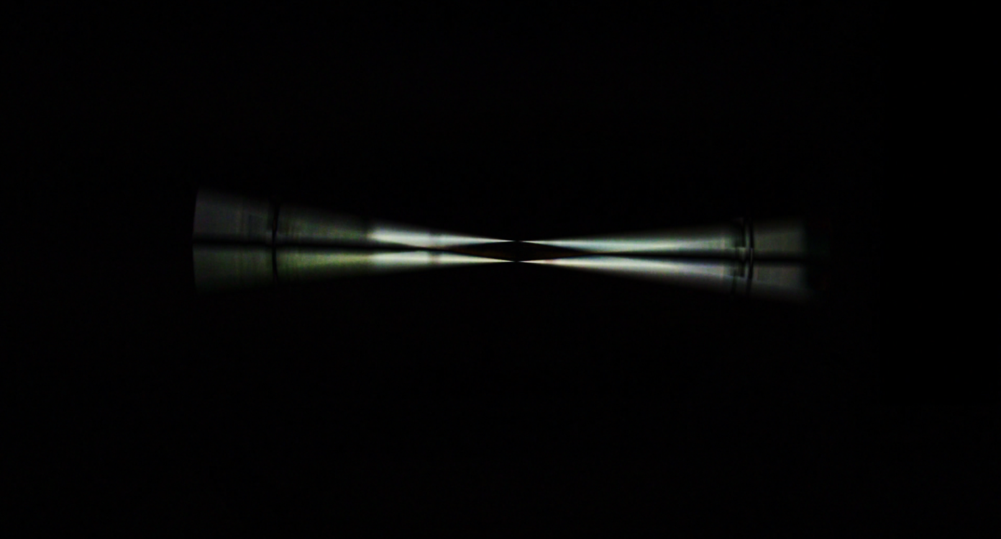
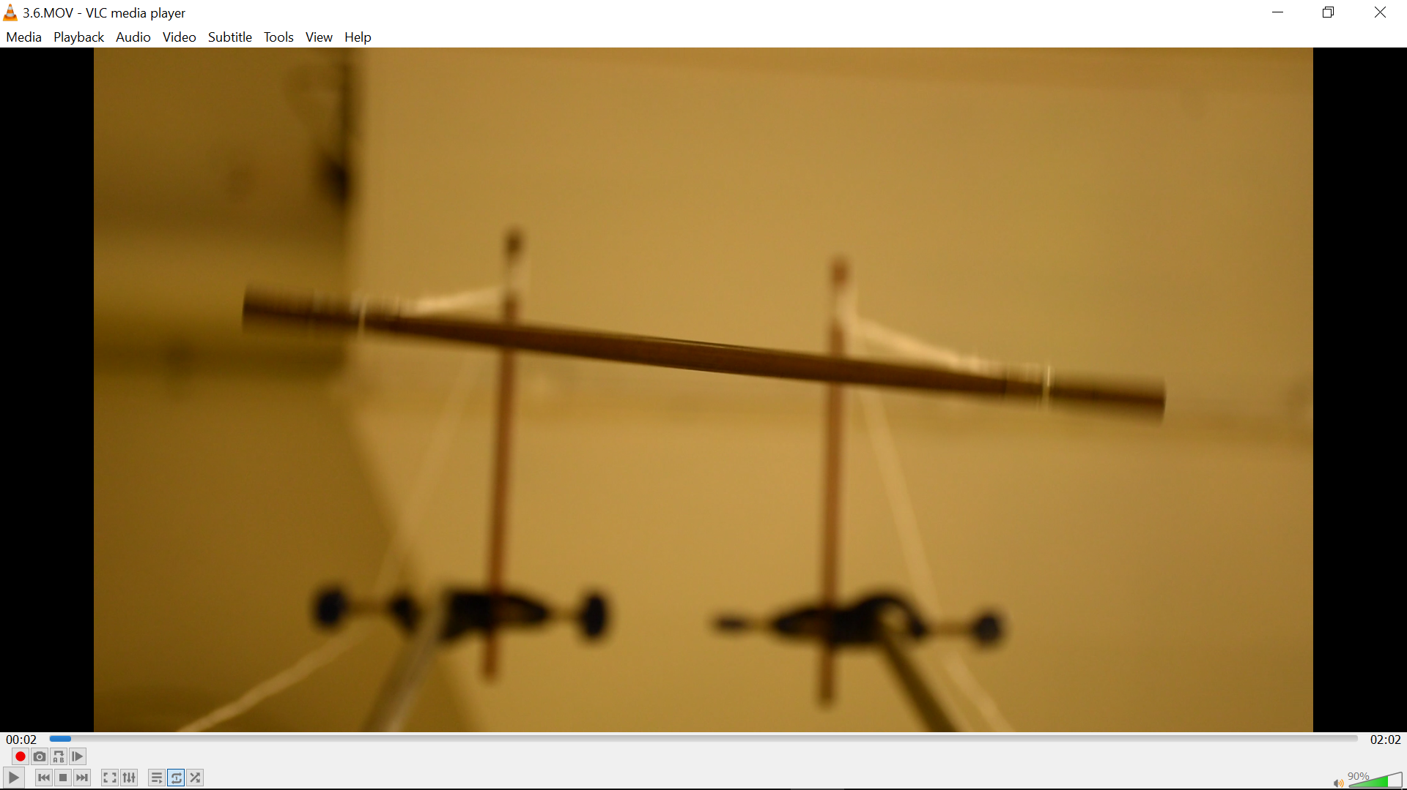
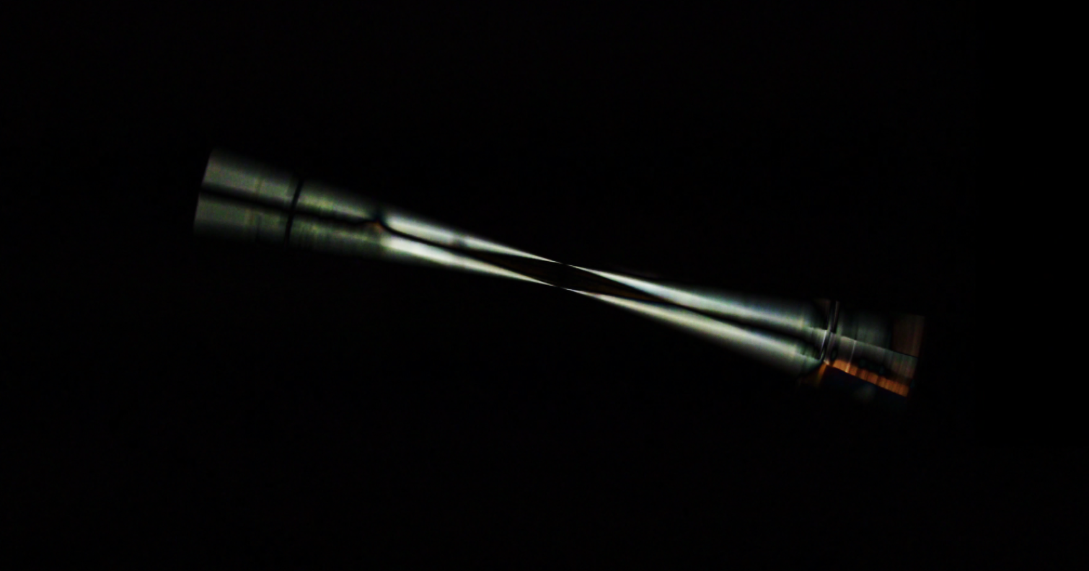
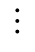
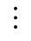
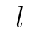
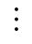
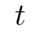
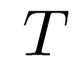
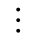
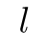
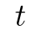
Compute the absolute difference of colour for each pixel between two consecutive images
Compute luminance of the greyscaled difference frame
Raw frames
Difference frames
Luminance
2.3298%
1.7543%
$$⋮$$
$$⋮$$
$$⋮$$
Plot luminance over time
$$l$$
$$l$$
mean+sd?
half-range?
Obtain the local minima of luminance per unit time, as it indicates that when the rotational motion of the rod approaches zero.
2.3298%
$$T$$
1.7543%
$$⋮$$
$$t$$
$$t$$
Multiplying time needed to finish half an oscillation by 2 gives the period.

Slide 5
Plotted on y-axis
Slope of graph
Plotted on x-axis
y-intercept

Slide 6
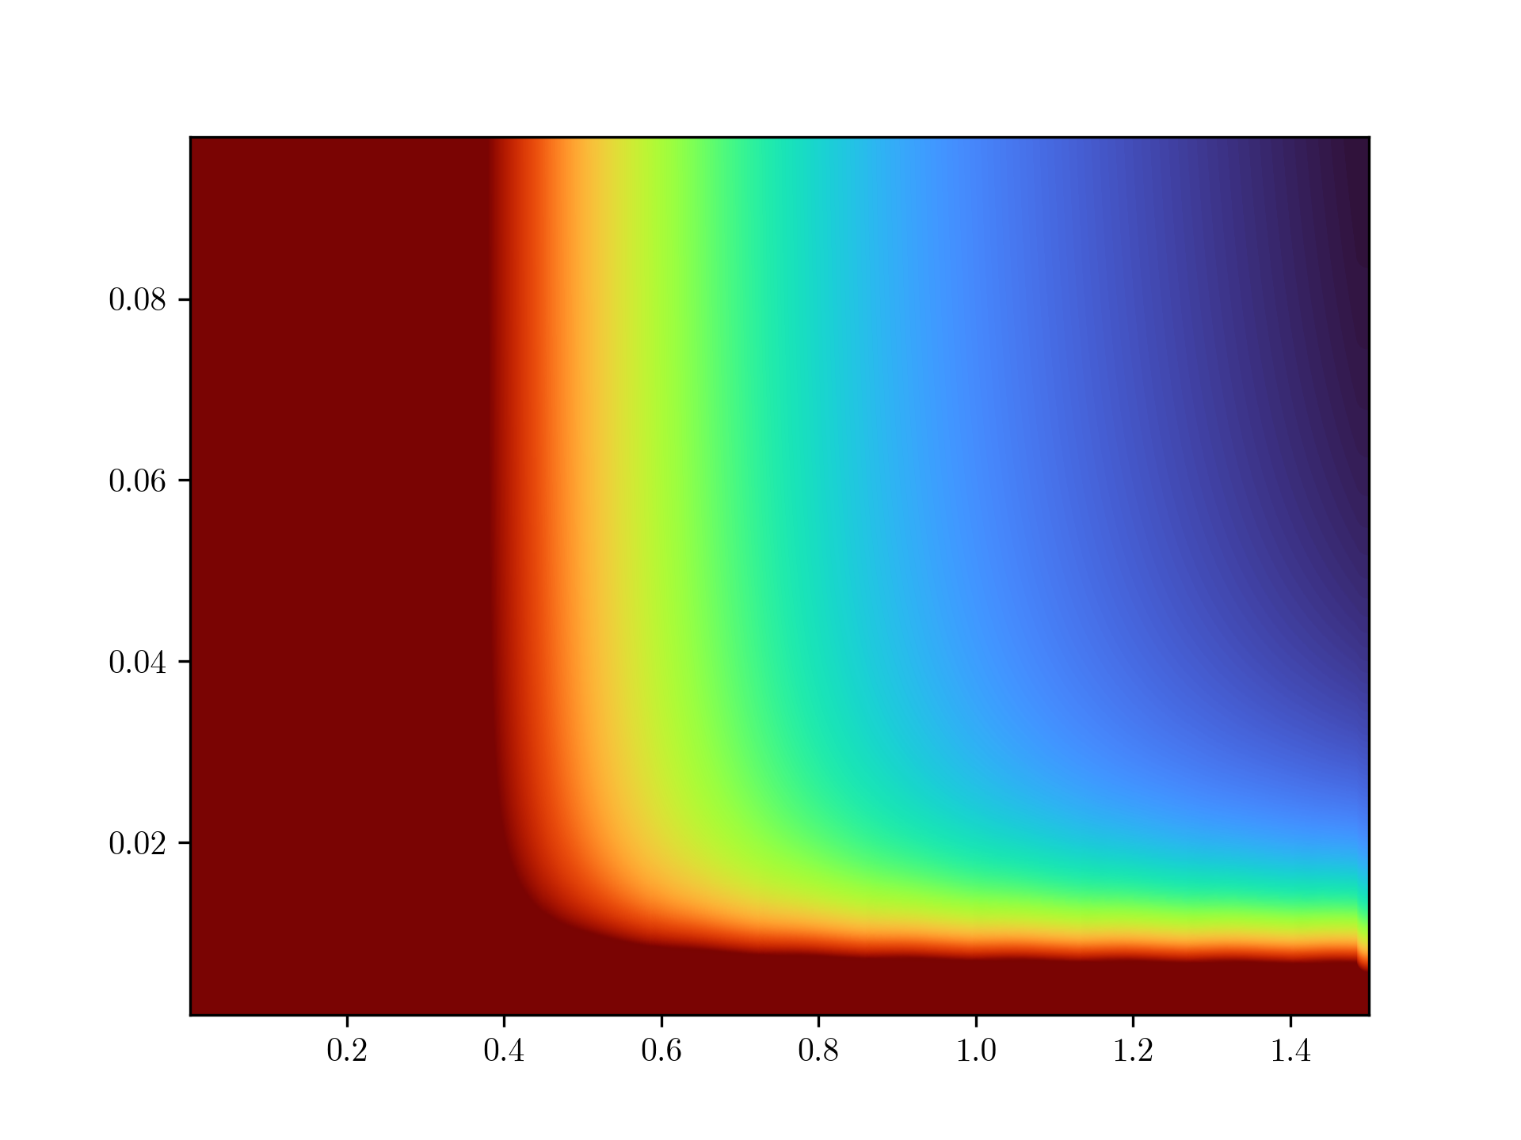

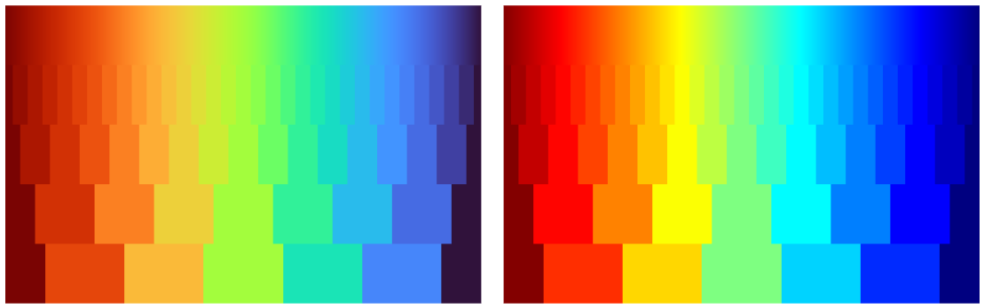
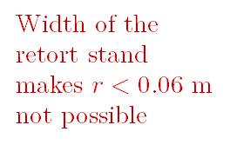
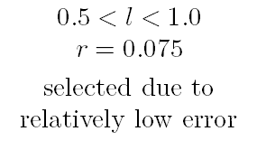
Mattey (1974), Kane and Tseng (1967) suggested filar lengths should be at least 4 times the radius of gyration to avoid chaotic motion
Height of table and the clamp and stand is 1.2 m
$$0.5<l<1.0$$
$$r=0.075$$
selected due to relatively low error
>15%
Width of the retort stand makes $r<0.06 m$ not possible
Percentage error in period T
Radius of gyration r / m
Error for
r < 0.015 m is high
<4%
Length of filars l / m

Slide 7
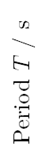
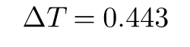
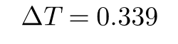
$$ΔT=0.339$$
$$ΔT=0.443$$
Period $T$ / s
Length of filars l / m

